Slide 1
Activity 2: PROPERTIES AND APPLICATIOON OF 2D FOURIER TRANSFORM PART 2
Genesis Vertudez – 202003099
App Physics 157 - Computational Analysis and Modeling in Physics
Submitted to Dr. Maricor Soriano; Mx. Rene Principe Jr.

Slide 2
OBJECTIVES
Use Fourier transform to manipulate images
Convolve images with patterns to apply it to them
Convolve images with filters to improve them
Use Fourier transform to locate certain patterns in images

Slide 3
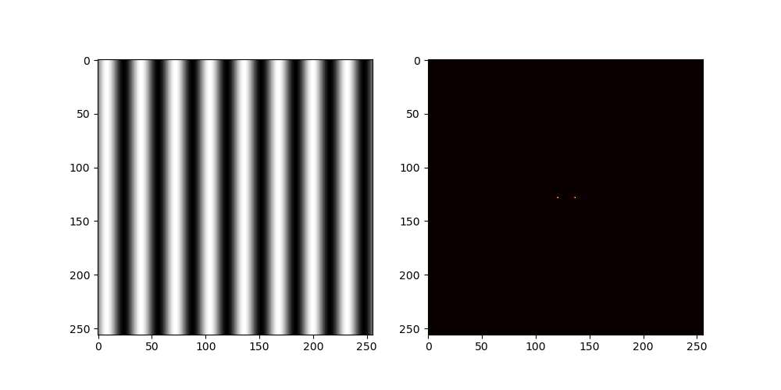

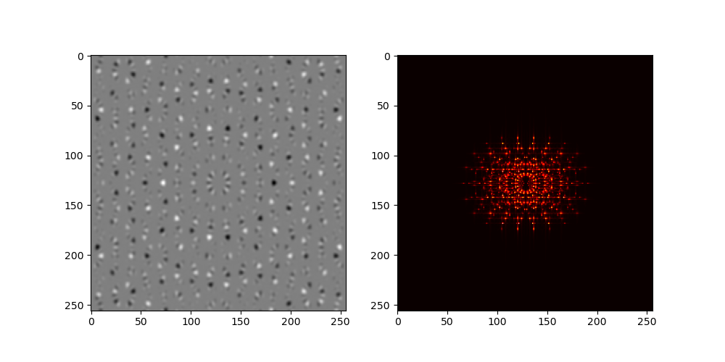
ROTATION PROPERTIES OF FT
The Fourier transform of a sinusoid are two Dirac delta functions, which are represented by a pixel, separated by the magnitude of the frequency, as seen in the first picture on the left.
Interestingly, rotating the sinusoid also rotates its Fourier transform as seen in the second picture on the left.
The third picture below shows products of sinusoids rotated at different angles. The Fourier transform of this image is then a beautiful sum of rotated Dirac deltas.
Sinusoid
Rotated sinusoid
Product of rotated sinusoids
Codes and files: https://github.com/genvert/AP_157_FX-2_Vertudez/tree/main/Activity%202%20Part%202

Slide 4
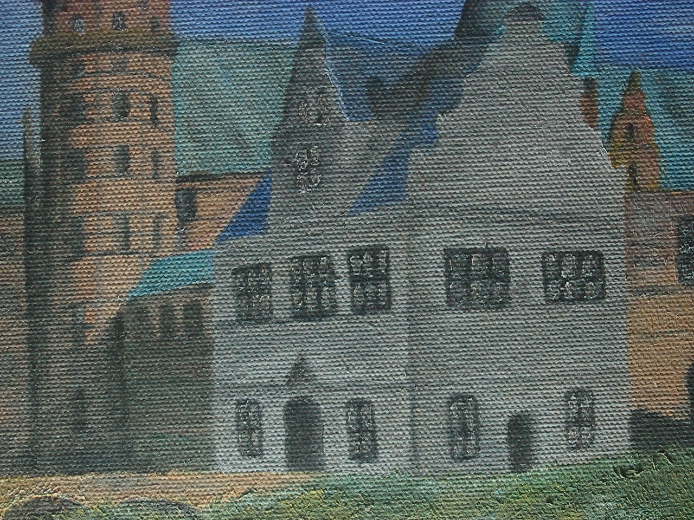
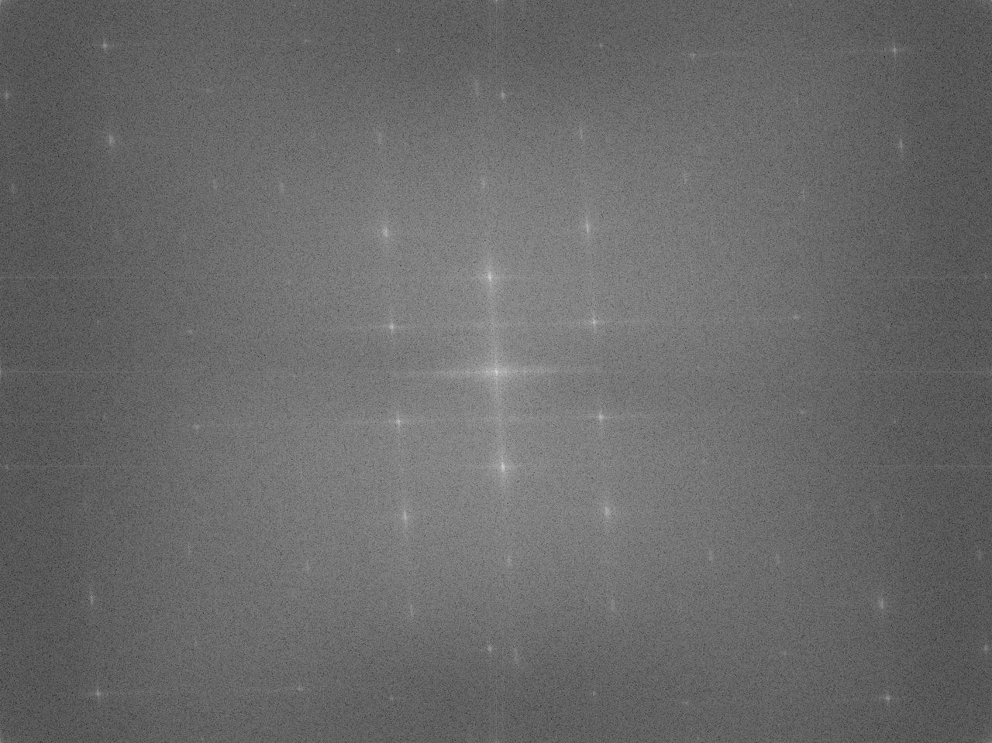
FILTERING IN FOURIER SPACE
One application of the Fourier transform (FT) is filtering images with unwanted repeating patterns.
On the left is an image of a painting on a canvas by Dr. Daria. We would like to remove the weaving pattern of the canvas to see and analyze the painting better. Taking the FT of (the grayscale) of the image, we see multiple peaks (Dirac deltas) which correspond to the FT of the periodic patterns (which can be represented by sinusoids).
The goal is to remove these peaks and hence remove the periodic pattern on the image.
Painting by Dr. Daria
FT of painting
Codes and files: https://github.com/genvert/AP_157_FX-2_Vertudez/tree/main/Activity%202%20Part%202

Slide 5
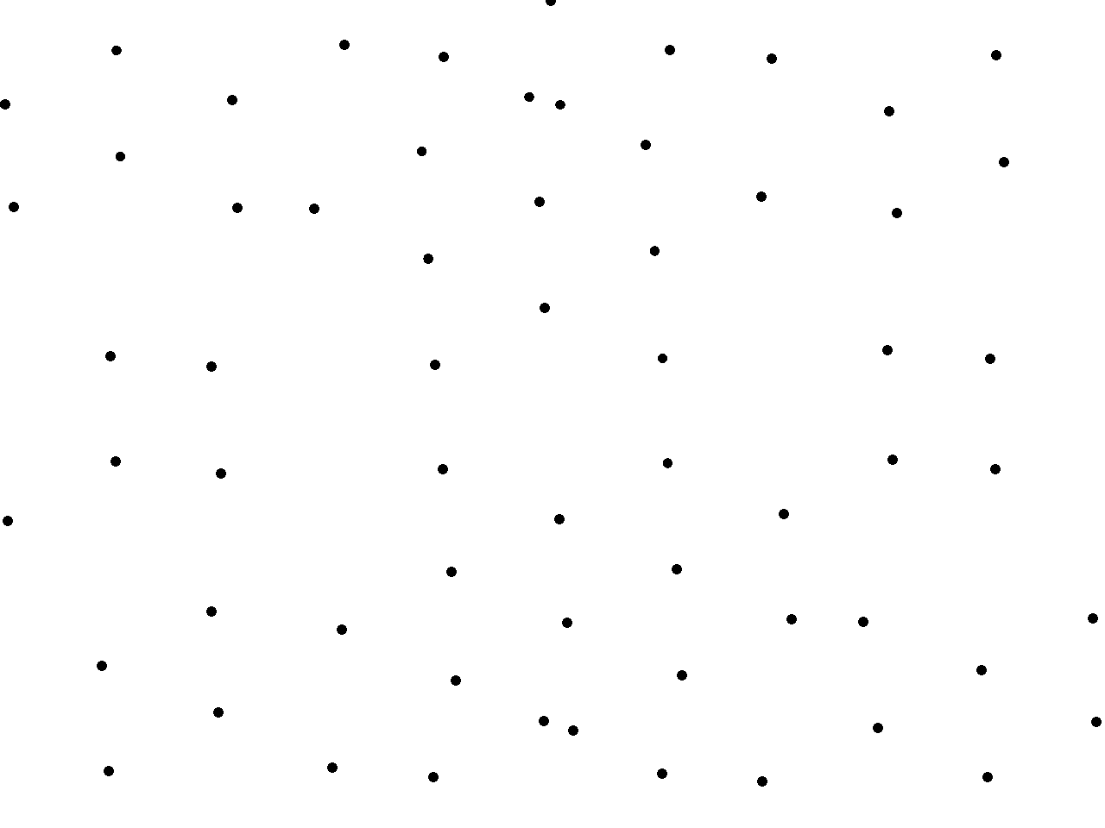
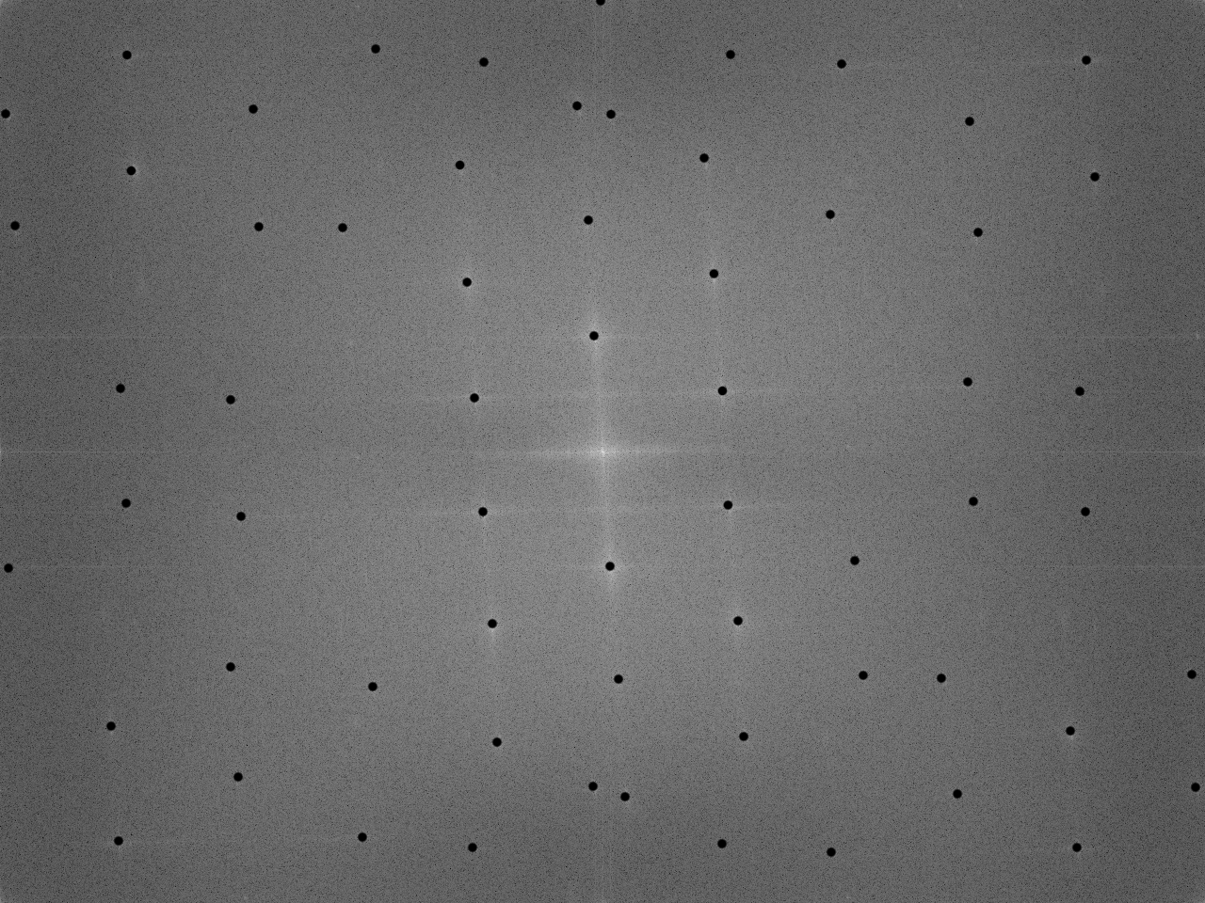
FILTERING IN FOURIER SPACE
This can be done by creating a mask, a binary image where white pixels are represented by 1’s and black pixels are represented by 0’s. We make sure that the black pixels of the mask correspond to the peaks on the FT. This way, by multiplying the mask with the FT of each channel of the original image (not grayscale), the peaks are “turned off” because they are multiplied by zero.
The image on the top is one example of a mask made for the FT of the painting image. Below it is the superimposed image of the mask on the FT. Take note that we do not cover the center peak, since this actually contains the information of the image itself.
Mask
Mask superimposed on FT
Codes and files: https://github.com/genvert/AP_157_FX-2_Vertudez/tree/main/Activity%202%20Part%202

Slide 6
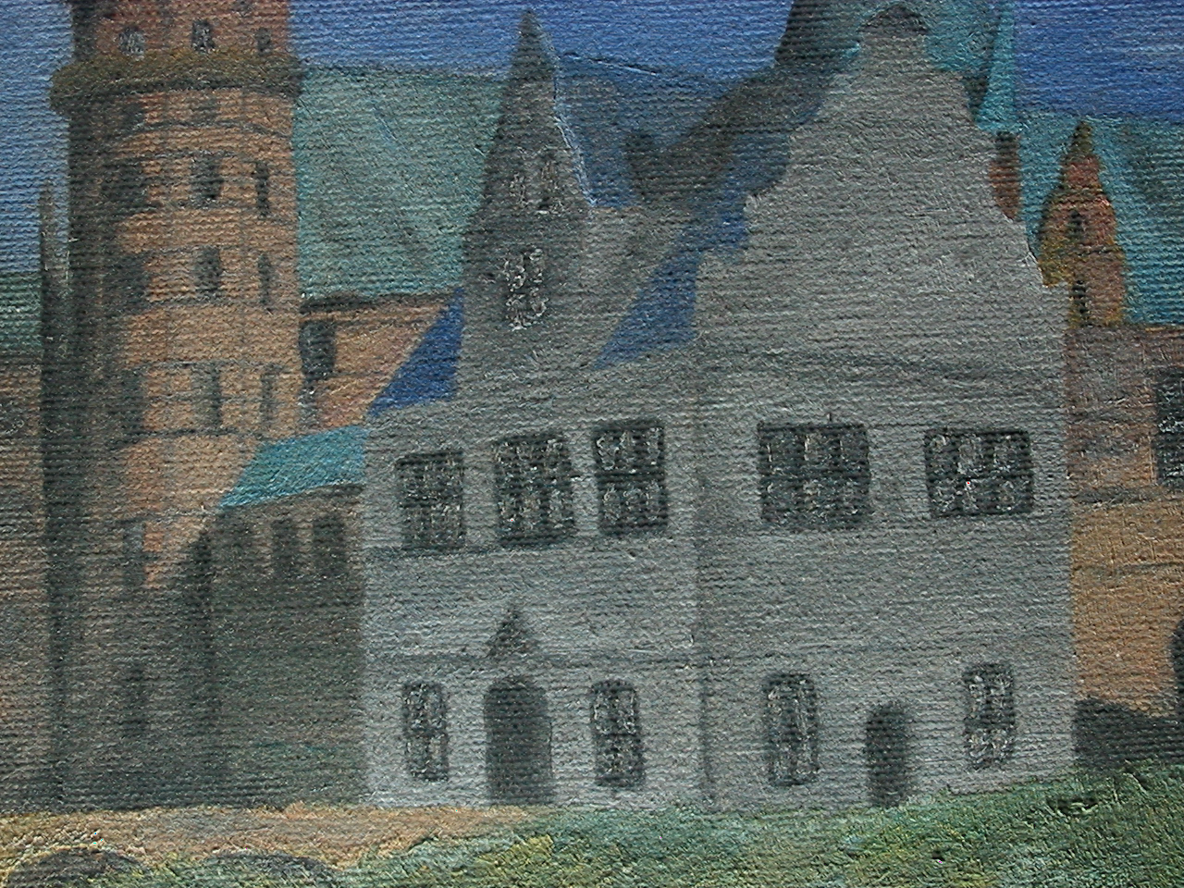
FILTERING IN FOURIER SPACE
The final step is to perform the inverse Fourier transform on the resulting product of the mask and the FT. The image below on the right shows the result of this process. It can be seen that the weaving patterns are significantly removed from the image. You may still notice some repeating patterns but that is attributable to an imperfect mask. This technique is useful for obtaining images obscured by repeating patterns.
Original painting
Deweaved painting
Codes and files: https://github.com/genvert/AP_157_FX-2_Vertudez/tree/main/Activity%202%20Part%202

Slide 7
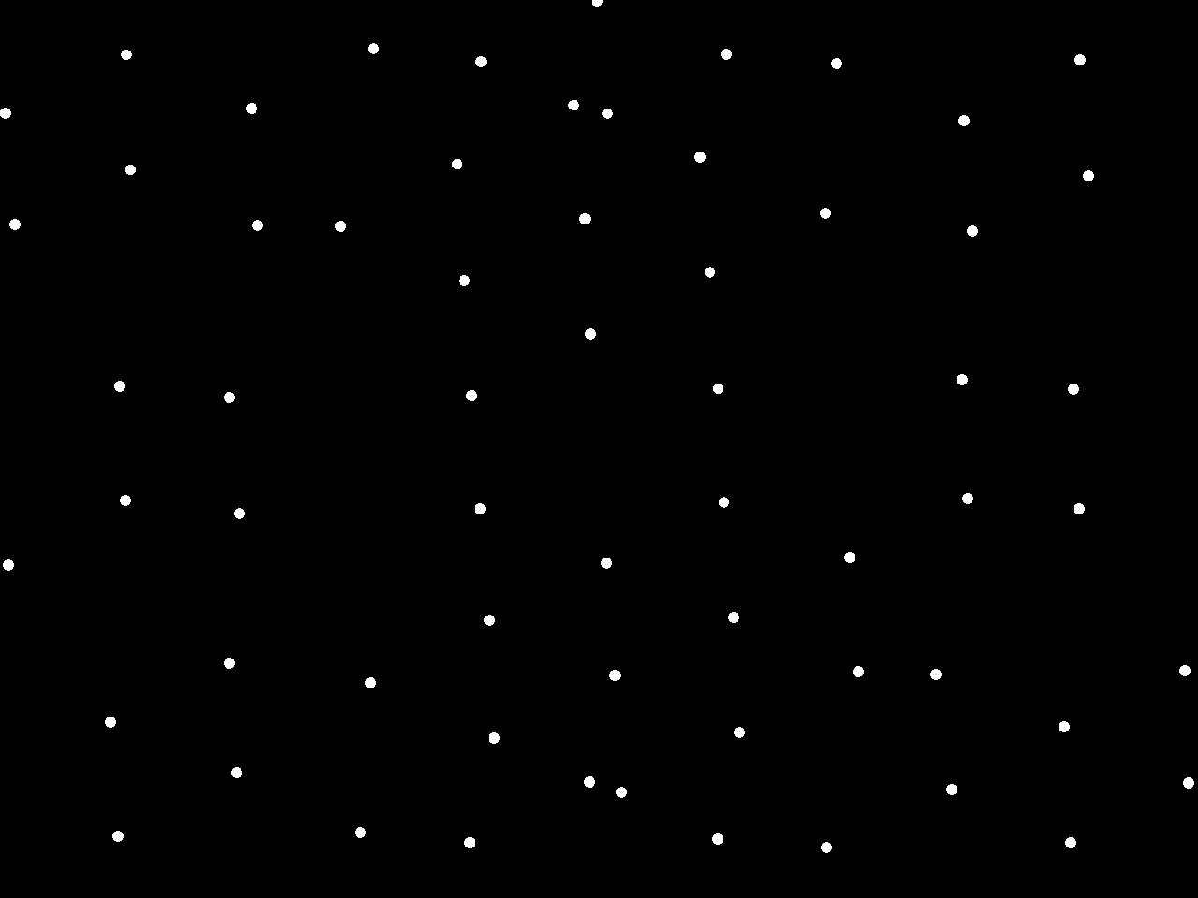
FILTERING IN FOURIER SPACE
The inverse of the mask can be used if you want to get the weaving pattern instead of the underlying painting. This time, the peaks are retained while the other parts are “turned off”. The image on the right shows the inverted mask
FT
Inverted mask
Codes and files: https://github.com/genvert/AP_157_FX-2_Vertudez/tree/main/Activity%202%20Part%202

Slide 8

FILTERING IN FOURIER SPACE
Here is the retrieved weaving pattern from the painting.
Original painting
Weaving pattern
Codes and files: https://github.com/genvert/AP_157_FX-2_Vertudez/tree/main/Activity%202%20Part%202

Slide 9
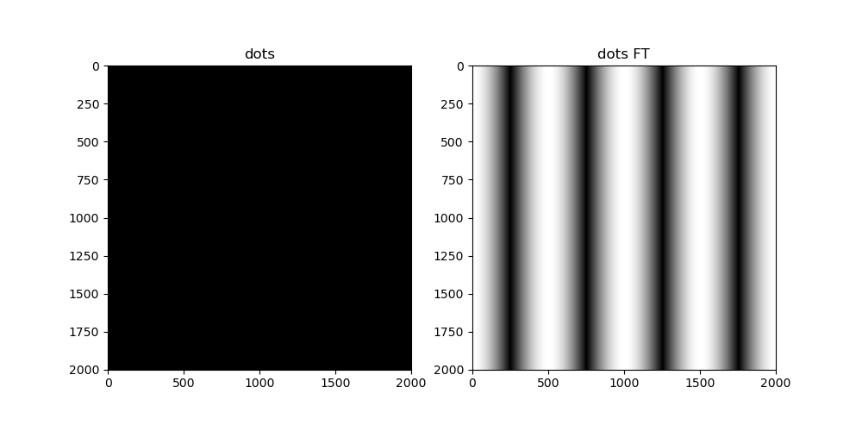
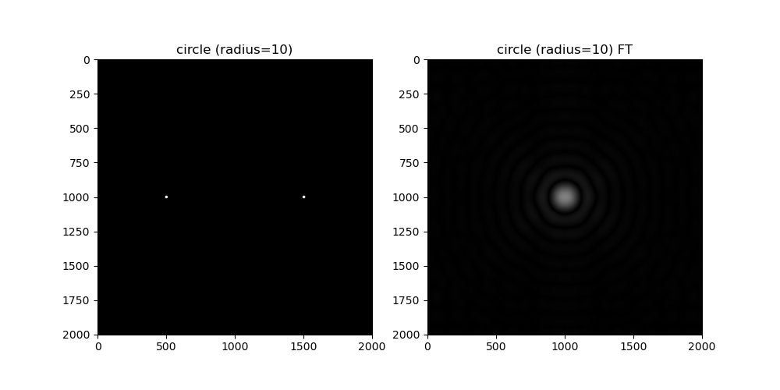
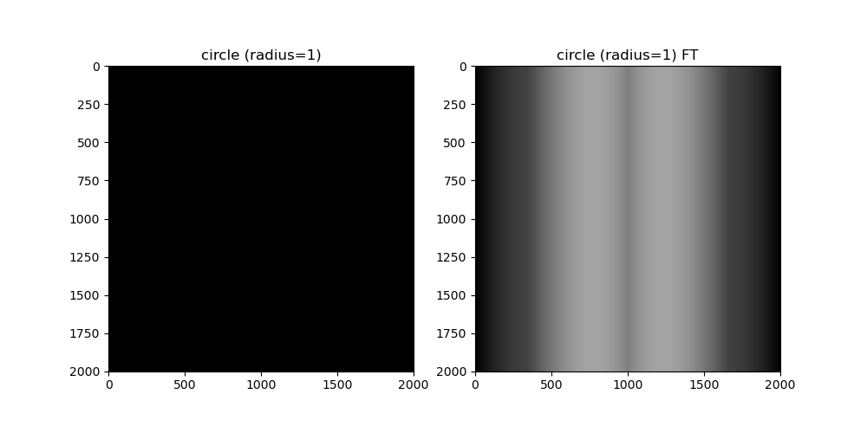
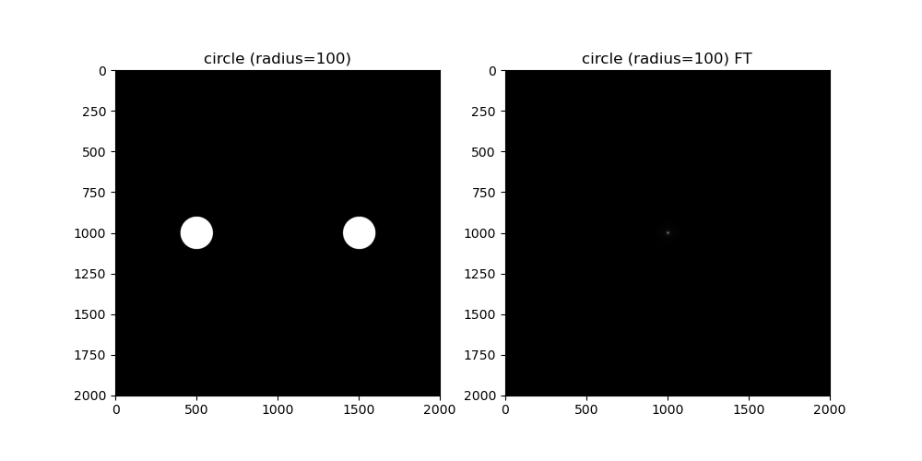
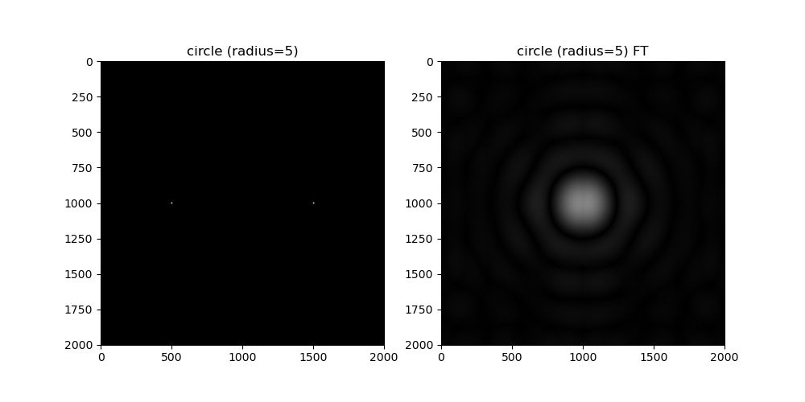
CONVOLUTION THEOREM REDUX
In this section, we revisit some properties of the Fourier transform.
The images on the side are circles of radii 0 (which is just a pixel, or a Dirac delta), 1, 5, 10, and 100, separated by some distance, and their FTs.
Recall that the FT of sinusoids are Dirac deltas, and this is true vice versa as seen from the first image. The resulting FT of the circles with higher radius are just products of multiple sinusoids, resulting in a circular diffraction pattern with inversely proportional radius.
Codes and files: https://github.com/genvert/AP_157_FX-2_Vertudez/tree/main/Activity%202%20Part%202

Slide 10
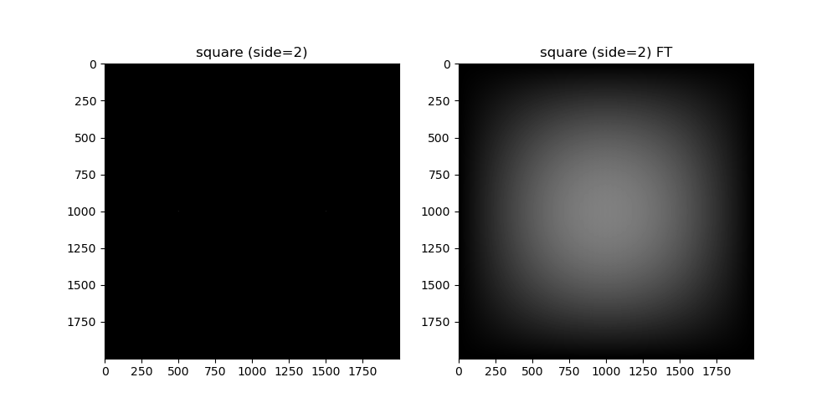
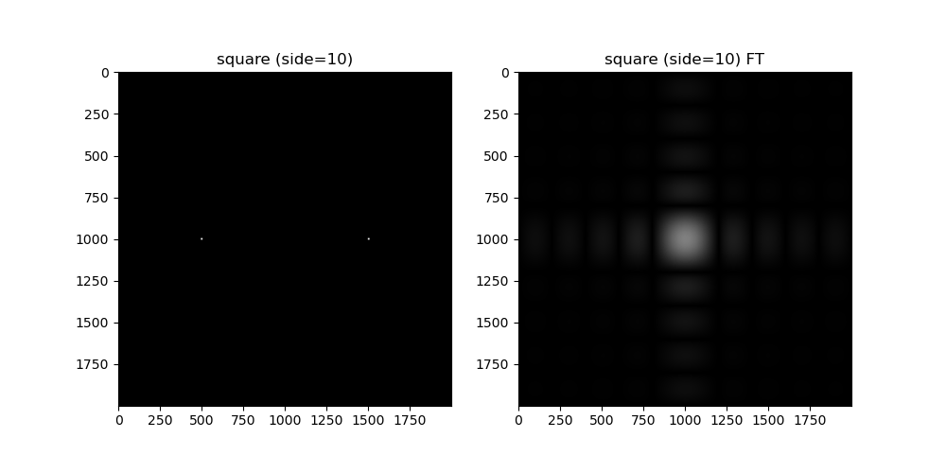
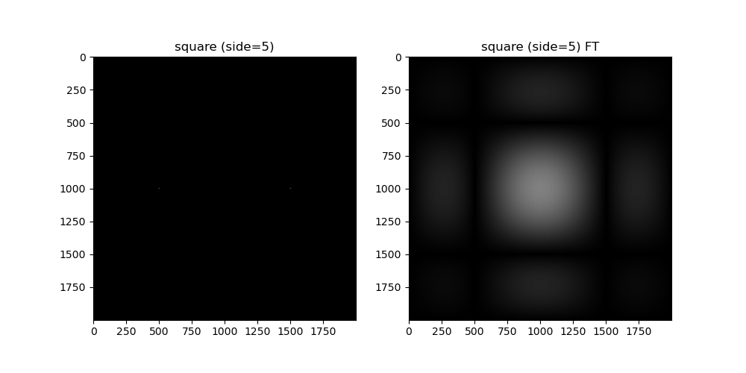
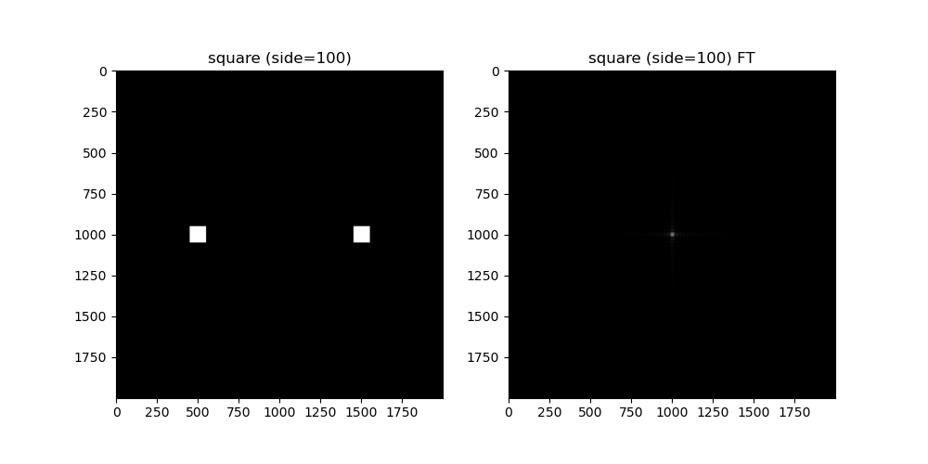
CONVOLUTION THEOREM REDUX
Replacing the circles with squares, we see that the same thing happens, except now the FTs form a square diffraction pattern.
Codes and files: https://github.com/genvert/AP_157_FX-2_Vertudez/tree/main/Activity%202%20Part%202

Slide 11
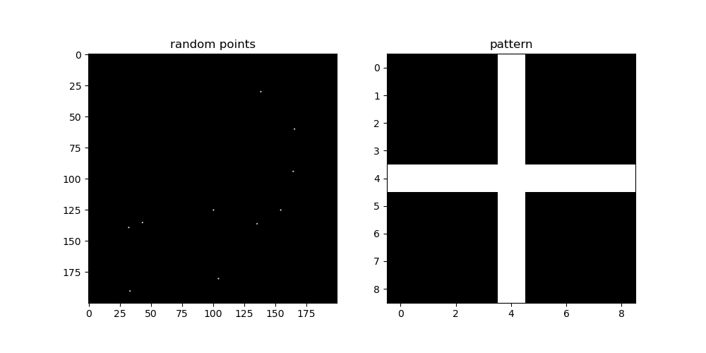
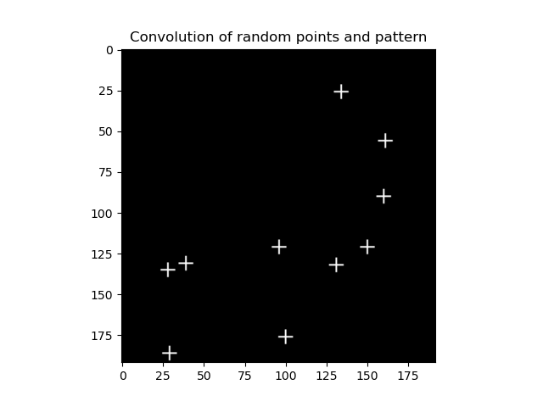
CONVOLUTION THEOREM REDUX
In the previous activity, we demonstrated how convolving a circular diffraction pattern with NIP letters made the NIP letters fuzzy.
This is an interesting property of Dirac deltas, wherein convolving them with a function copies the function at the location of the Dirac delta. In image processing, convolving a pixel (represents a Dirac delta) with an image (represents the function) copies the function at that location.
On, the image above on the left, I generated 10 random points on the grid, and created a simple plus symbol image. By convolving the two images, we see that the plus images are copied into the locations of the 10 randomly generated pixel points.
Codes and files: https://github.com/genvert/AP_157_FX-2_Vertudez/tree/main/Activity%202%20Part%202

Slide 12
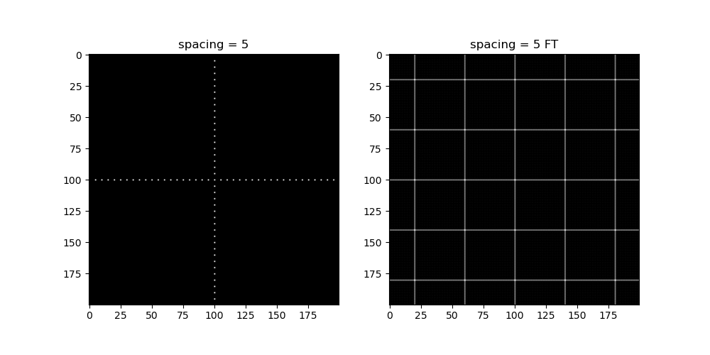
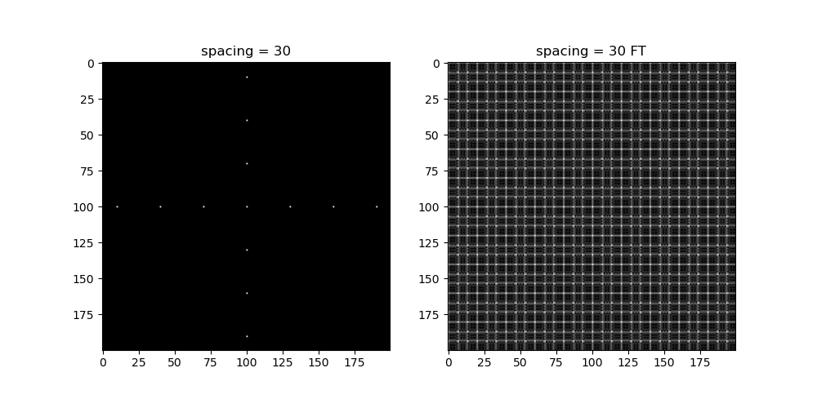

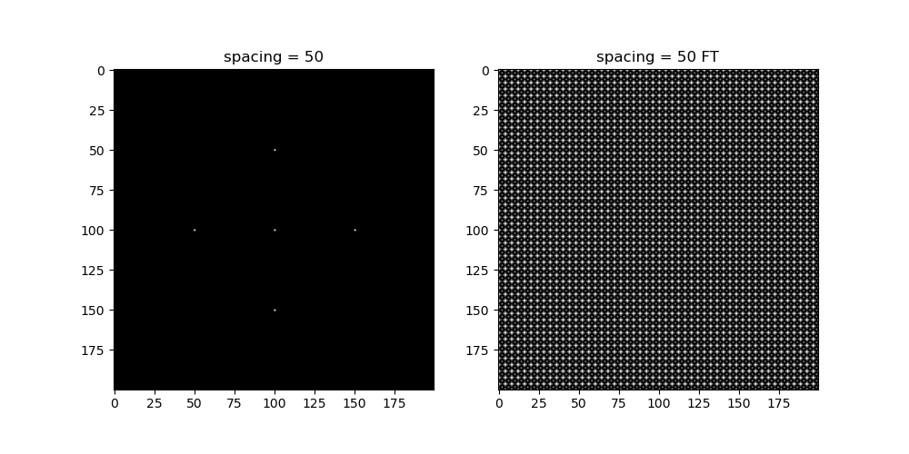
CONVOLUTION THEOREM REDUX
In this example, we lay out equally spaced pixels along the x and y axes.
We see that the resulting FTs are grid-like images. This makes sense since the spaced-out pixels are sum of multiple Dirac delta pairs each with sinusoid FTs. Since addition carries to the frequency domain, the FTs are just sum of the sinusoids where a lot cancels except for the peaks
Codes and files: https://github.com/genvert/AP_157_FX-2_Vertudez/tree/main/Activity%202%20Part%202

Slide 13
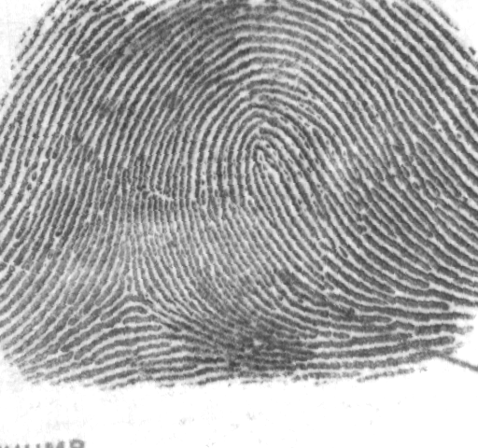
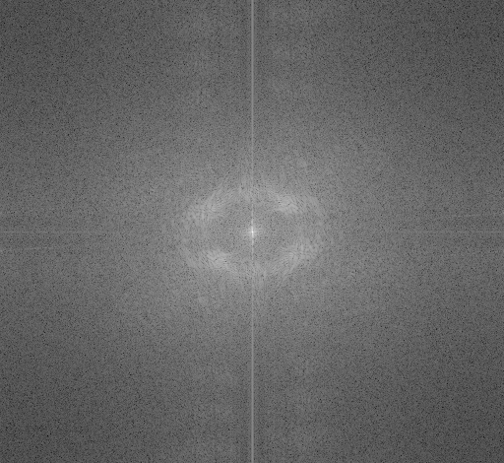
FINGERPRINT: RIDGE ENHANCEMENT
Fingerprint analysis is another application of Fourier transform. By enhancing the ridges on the image, the fingerprint will be clearer and more useful in forensic science, for example.
The image above on the left shows a fingerprint. Taking its FT, we see that there are clear white regions surrounding the center and along the vertical axis.
Fingerprint image
FT of fingerprint
Codes and files: https://github.com/genvert/AP_157_FX-2_Vertudez/tree/main/Activity%202%20Part%202

Slide 14
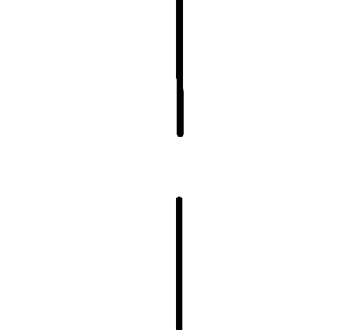
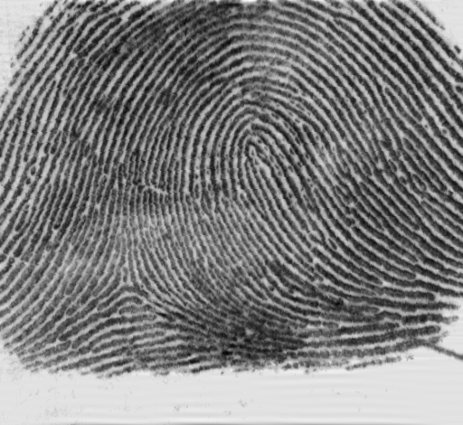
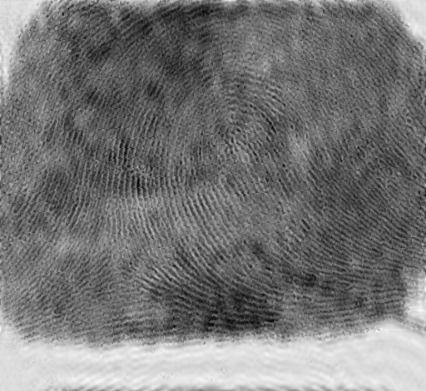
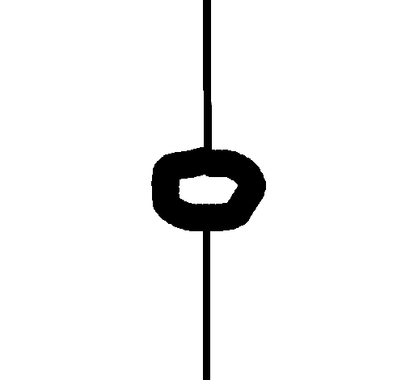
FINGERPRINT: RIDGE ENHANCEMENT
Here, we try two masks. One which only covers the vertical white region, and another which covers the surrounding white region as well.
As can be seen on the right, the first mask does a better job in enhancing the fingerprint. The second mask actually blurs out the fingerprint image.
This is due to the fact that the center of the FT contains most of the information of the image, and obscuring its surroundings deleted some of the important information.
Mask 1
Result 1
Mask 2
Result 2
Codes and files: https://github.com/genvert/AP_157_FX-2_Vertudez/tree/main/Activity%202%20Part%202

Slide 15
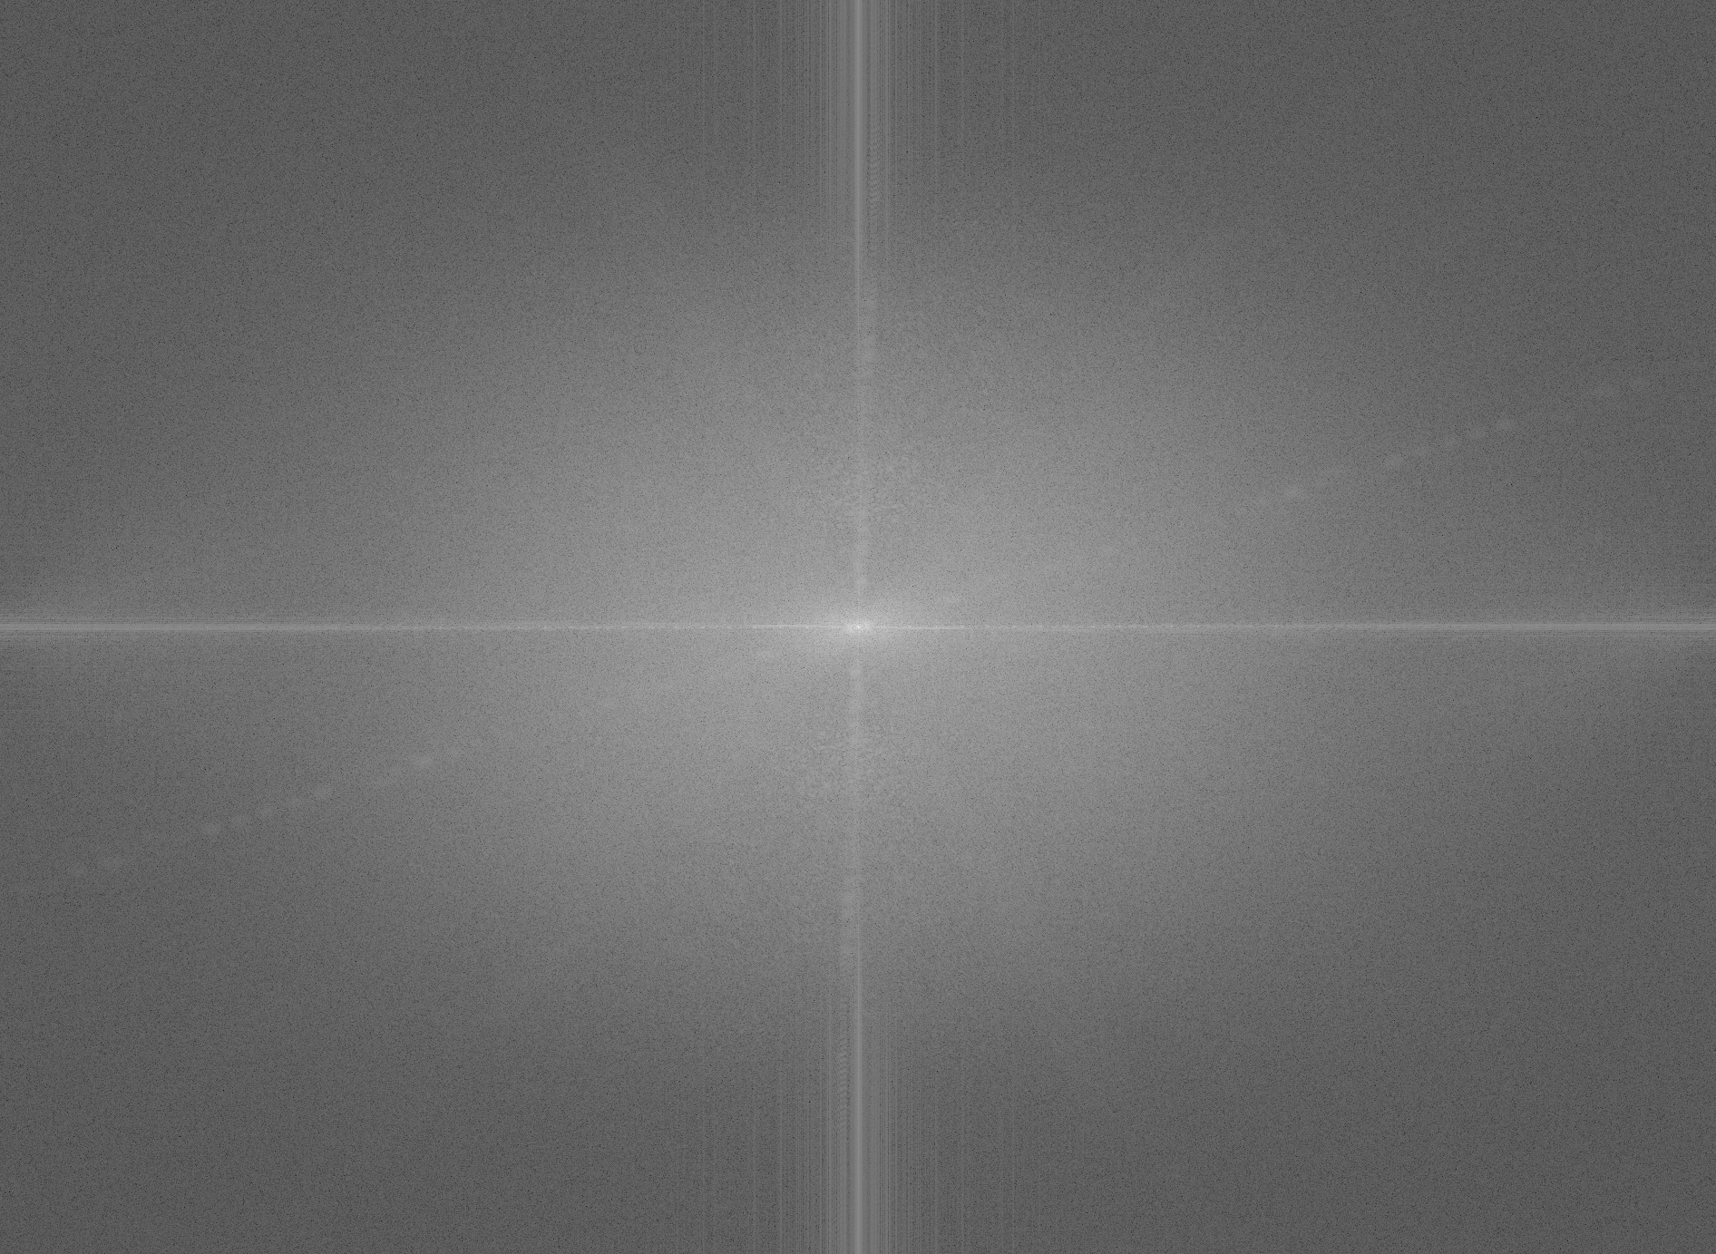
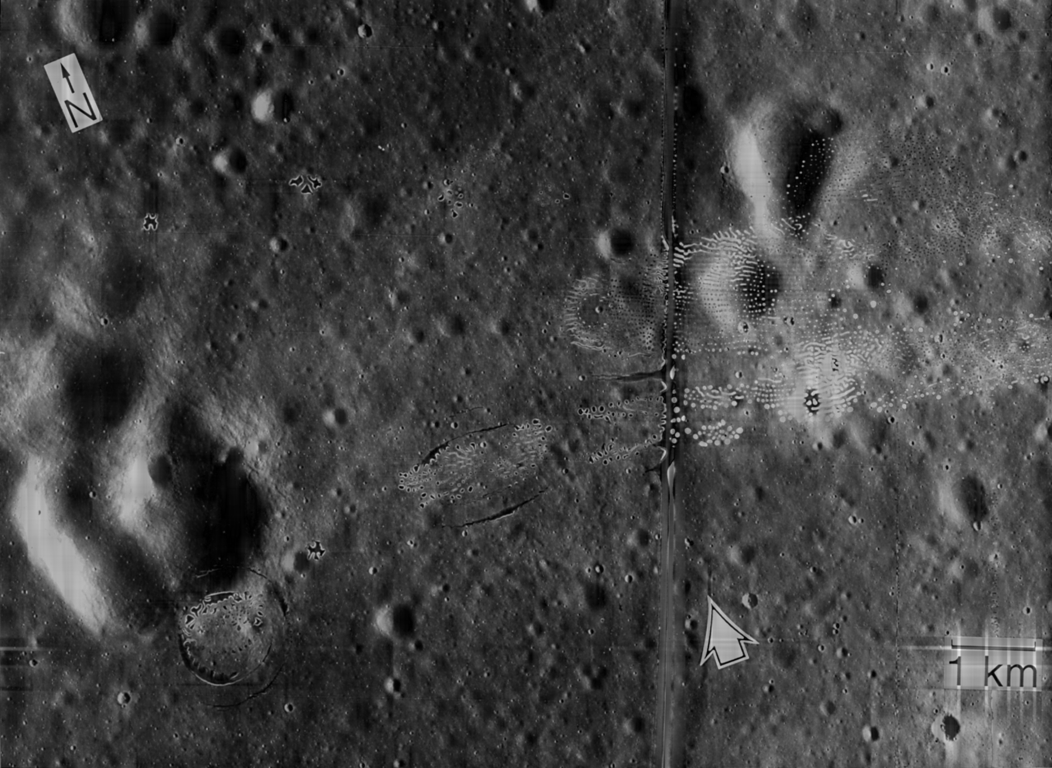

LUNAR LANDING SCANNED PICTURE: LINE REMOVAL
This last application is straightforward. The image above on the left shows an image of the lunar landing. These are actually four images stitched together because they had to take pictures of each region on the moon individually. Because of this, the lines from the stitching are visible.
To remove this line, we take a look at the FT of the image, shown on the picture above on the right. There is a clear white region along the x and y axis. Therefore, the appropriate mask is of the same shape as shown below on the right, again avoiding the center.
The image on the bottom left shows the final result of the convolution. It has removed the lines, but you can notice that the image got darker. This is due to the mask covering some information on the intensity. Still, this is a nice result.
Lunar image
FT
Enhanced image
Mask
Codes and files: https://github.com/genvert/AP_157_FX-2_Vertudez/tree/main/Activity%202%20Part%202

Slide 16
REFLECTION
This activity was very fun. It was repetitive (in a nice way) which made me get very familiar with the application of Fourier analysis in image processing.
The previous activity was definitely helpful in letting me understand the ideas behind the removal of periodic patterns.
I just want to say that the product of rotated sinusoids produce beautiful Fourier transforms!

Slide 17
SELF-GRADE
Technical correctness: 35/35
I am confident that I understood how the Fourier transform of images work and how to manipulate their properties for image processing.
Quality of presentation: 35/35
I have explained each step and idea, and images are clear and concise.
Self-reflection: 30/30
The activity was repetitive in using Fourier transform so it helped me strengthen my knowledge on it.
Initiative: 10/10
I went beyond the expected output.

Slide 18
REFERENCES
[1] Soriano, M. (2023). AP 157 module. Activity 2 Part 2 - Properties and Applications of the 2D Fourier Transform 2021 – Copy.
[2] Fingerprint photo. https://www.researchgate.net/figure/Examples-of-different-classes-of-fingerprints-a-right-loop-b-whorl-and-c-arch_fig2_265986190
[3] Lunar landing photo. https://www.lpi.usra.edu/publications/slidesets/apollolanding/ApolloLanding/slide_05.html

